Slide 1
The Relational Parser Racket/miniKanren + OMeta
Max Snyder

Slide 2
Background
Relational Programming
Parsing
No Input vs. Output
Functions are “Goals”
Search via Unification
Input
Grammar
Without Semantics – Recognizer
With Semantics – Parser, OMeta
Input Stream, from Tokenizer
Output
Output Value
Without Semantics – Boolean
With Semantics – Semantic Value
Un-Parsed Stream of Tokens

Slide 3
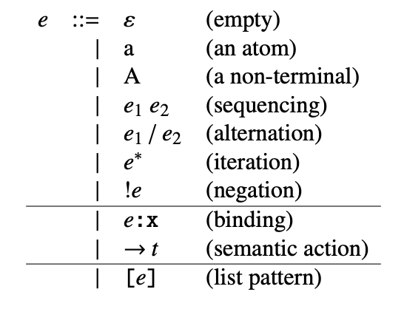

Background
Relational Programming
Parsing
Racket/miniKanren
mK is a Relational Meta-Language
mK implements evalo
expr is Racket or Scheme
val is the “return value”
Either input can be constrained
Partially or Completely
Core-OMeta

Slide 4
Motivation for The Relational Parser
Given a grammar, query for possible valid inputs under that grammar.
Given a grammar and an output value, query for possible valid inputs under that grammar that yield the output value. The output could be:
A value (e.g. query for programs that return 42)
A program (e.g. query for C programs that compile to given x86 code)
Given a set of input programs, query for possible recognizers.
Given a set of input/output pairs, query for possible semantics.

Slide 5
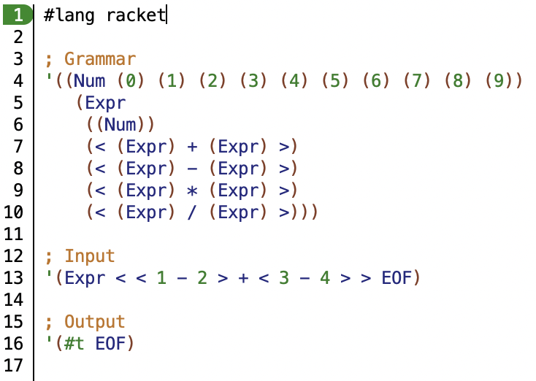
Example

Slide 6
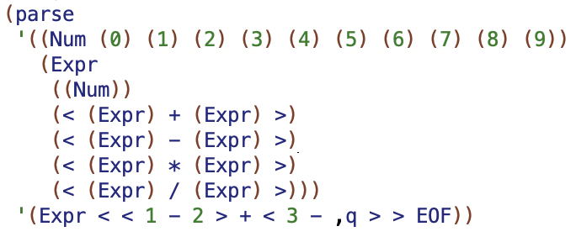


Example

Slide 7
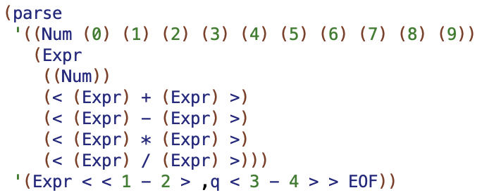

Example

Slide 8
Examples
Relational Recognizer
Last Three Slides
Supported Today
Relational Interpreter
Value of the Input Expression
Supported Soon
Relational Compiler
Translation to a Lower-Level Language
Supported Soon

Slide 9
Goals and Aspirations
PEG Recognizer in Racket/mK, Solved Relationally
[Atoms]
[Non-Terminals]
[Sequencing]
[Alternation]
Iteration
Negation
Lists
OMeta (PEG + Semantics) in Racket/mK, Solved Relationally
Bindings
Semantic Actions
Relational PEG in mK – Aspiration
Relational OMeta in mK – Aspiration

Slide 10
Q & A
The Relational Parser

